Slide 1
The Neurobiology Of Learning
John W. Pelley, PhD
john.pelley@ttuhsc.edu www.ttuhsc.edu/SOM/success/
Notes:
My goal is to serve as a catalyst.
What are the characteristics of a catalyst?
Interact with reactants – me talking to you
Lower activation energy – me telling how
Unchanged by reaction – getting on the plane and leaving
Ineffective with nonspontaneous reaction – you staying the same

Slide 2
If you don’t know where you are going, any path will take you there

Slide 3
“The purpose of an educational institution is to lead the students, who initially believe the educational institution is there to educate them, to the realization that they must educate themselves.”
“They must …learn how to learn [integratively]…”
From Willis Hurst, MD, Medscape
[and Pelley]
Notes:
Welcome slide.
How do we help students learn? Generally by telling them what to learn and then letting them go learn it.
We expect that this learning will be remembered,
We teach by organizing, by giving examples, and by modeling thinking.
In fact, we do everything for them while they watch.
You don't help people by doing their thinking for them.
The students must learn how and when to act on what they are supposed to learn.

Slide 4
Main Points Today
Students need to transform themselves from receiver role to producer role.
Receiving information vs producing knowledge
Transformation not demanded, but taught
Deliberate practice produces expert learning skills.
Responsibility for learning lies with student.
Growth Mindset requires Deliberate Practice.
The brain is wired to predispose thinking/learning “styles.”
Learning style is an insight for Deliberate Practice
Growth Mindset requires knowing how the brain works.
Notes:
A receiver of information cannot be a problem solver until they become a producer of knowledge.

Slide 5
Your Thalamus Distributes My Biochemistry Lectures To Your Cerebral Hemispheres
Thalamus volume setting is high or low (gain control)

Slide 6
Prefrontal Pause (1 minute)
Getting In Touch With Your Thalamus
Thalamus
base of brain
distributes all sensory information to higher centers
Thinking requires both input and memory
Talk with a neighbor about how you do your best thinking:
Talk it out first or,
Think it through first

Slide 7
Low Gain vs. High Gain
Talk it out – “low gain” thalamic activity; seeking more input; more active
Extraversion; low arousal level – too quiet
Lower cerebral blood flow, augmentation of “evoked response,” lower doses of sedatives
Think it through – “high gain” thalamic activity; reducing input; more reclusive
Introversion; high arousal level – too loud
Higher cerebral blood flow, reduction of “evoked response,” higher doses of sedatives

Slide 8
Why is it important to know how the brain works? Answer: It affects “Mindset” – and mindset affects performance Mindset: The New Psychology of Success, Dweck, C., 2006

Slide 9
Prefrontal Pause Turn to a neighbor and answer – (1 min)
When do you feel smart?
When you are learning
Studying for a test
Or,
When you are flawless
Making a perfect score on a test

Slide 10
Growth vs Fixed Mindset
Growth mindset – “When you are learning.”
“You can always change how intelligent you are.”
Fixed Mindset – “When you are flawless in performance.”
“You have a certain amount of intelligence and you can’t change it.”

Slide 11
Mindset Comparison
Fixed Mindset
Growth Mindset
Success based on innate ability
Failure is dreaded, feared.
Least likely to succeed
Success based on hard work and learning
Failure is a challenge to adapt.
Most likely to succeed

Slide 12
Growth Mindset Through Deliberate Practice
Designed specifically to improve performance
Myth: “Practice makes perfect.”
Reality: “Perfect practice makes perfect.”
Reality: “Deliberate practice is perfect practice.”
Deliberate Practice: Practice correcting weaknesses.
Deliberate practice requires self-awareness … and self-acceptance.
Need to avoid automated behavior
Loss of focus and attention, esp. while reading
(K. Anders Erickson, “Deliberate Practice and the Acquisition and Maintenance of Expert Performance in Medicine and Related Domains.” Academic Medicine, 2004;79:October Suppl.70-S81.)

Slide 13
Deliberate Practice Characteristics
Applied to limitation in skill
Can be repeated a lot
Feedback continuously available
Most effective with experienced teacher
Not work, not play – focused effort; demanding
Need to avoid automated behavior
Not much fun; motivation critical
Highly demanding mentally; tiring
Not aimed at minimum standards
Self-actualization is the standard
10 years, 10,000 hours – Gladwell, “Outliers”

Slide 14
At-Risk Syndrome – The Need For Expert Skills
Up until 2 am, reading and re-reading
Harder study = harder reading
Study effort ≠ test performance
Knew more than others who did better
Test questions are tricky
Notes:
Make sure these are referred to in sensing vs. n comparison

Slide 15
Myers-Briggs Personality Types And Learning Style
Preferences Influence how you learn.
Produces self awareness
Critical first step in Deliberate Practice
Affects academic performance
Also affects:
Communication skills
Choice of specialty

Slide 16
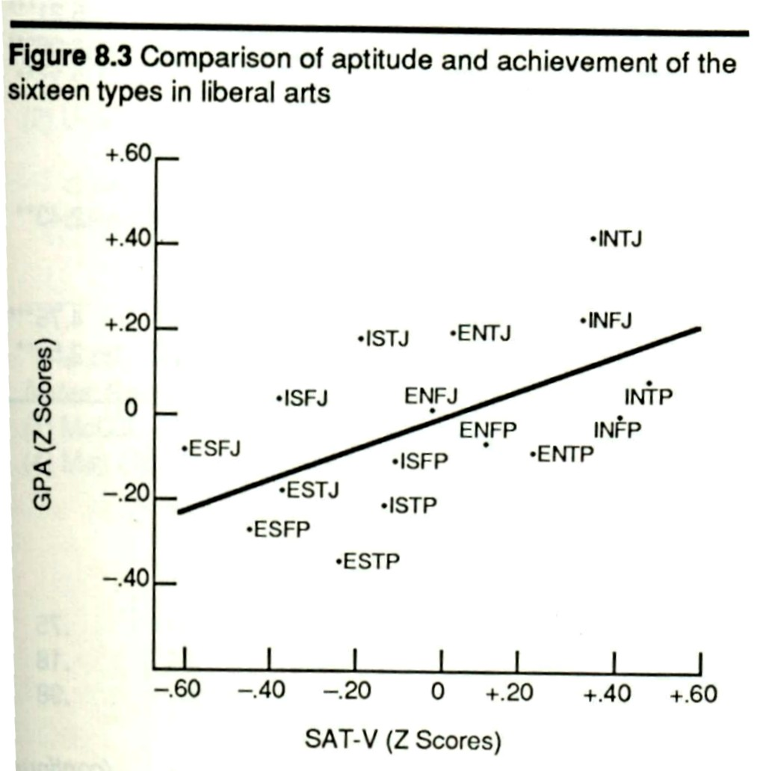

Slide 17
Myers-Briggs Personality Type – What It Is
Mental Model; many others also useful
Normal differences between people
Persistent tendencies (choices)
Do not change once established
e.g. Folding your arms, throwing a ball, writing your name
Comfort zone for thinking; requires less effort than the opposite
Use of opposite is a conscious effort

Slide 18
Myers-Briggs Personality Type – What It Isn’t
Not a measure of intelligence
Not a “limitation”
No negative aspects
No psychopathology
No stereotype

Slide 19
What Do Those Letters Mean?
Four dimensions of preferences
Extraversion (E) vs. Introversion (I)*
Sensing (S) vs. Intuition (N)*
Thinking (T)* vs. Feeling (F)
Judging (J) vs. Perceiving (P)*
*Pelley’s type

Slide 20
Prefrontal Pause
Talk for a minute with your neighbor about what your preference might be:
Think better with “facts and specifics”
Think better with “big picture and connections”
Try to give an example

Slide 21
Sensing (S) vs. Intuition (N)
What information do you give the most attention to?
Sensing types give their attention to specifics
Intuitive types give their attention to the big picture
Everyone does both, but only one is preferred.
Use of opposite is deliberate; not automatic

Slide 22
Test Taking Style
N style
First, seek answer that matches poorly memorized knowledge
Rule out answer choices
Don’t fit pattern
Big picture learning establishes patterns
S style
Seek answer that matches memorized knowledge
Re-read question to stimulate recall
Memorization learning requires recognition
Notes:
One step thinking vs. 2 and 3 step thinking

Slide 23
Memorization vs. HOTS
Memorization
Recall: remembering facts/details and their “organization” (list the symptoms of heart attack)
Preferred by sensing types
Higher Order Thinking Skills (HOTS)
Grouping: “organizing” facts into patterns
Comparing: relationships between patterns (list the causes of chest pain)
Preferred by intuitive types
Notes:
These will correlate later with steps in concept mapping

Slide 24
Integrative Learners
Linear Learners
Notes:
The initial goal was to help linear learners acquire skills used by the integrative learners.

Slide 25
Thinking (T) vs. Feeling (F)
How do you react to new information?
Thinking types consider the logical implications.
Feeling types consider the impact on people.
Everyone does both, but only one is preferred.
Use of opposite is deliberate; not automatic

Slide 26
Judging (J) vs. Perceiving (P)
How do you manage your life?
Judging types prefer to be planned, organized (joy of closure).
Perceiving types prefer to be flexible, adaptive (joy of discovery).
Everyone does both, but only one is preferred.
Use of opposite is deliberate; not automatic

Slide 27
How Do Preferences Relate To Learning?
Extraversion: Good at initiating
think out loud and then think alone
Introversion: Good at reacting
think alone and then think out loud
Sensing: Enjoy using what already learned
bring details but neglect relationships
Intuition: Enjoy learning new things
bring patterns and relationships but missing some details

Slide 28
How Do Preferences Relate To Learning?
Thinking: Learn best when given a clear and objective rationale
give and receive objective criticism
Feeling: Learn best when given personal encouragement
bring harmony; sensitive in communication
Judging: Value orderly use of information
complete tasks at expense of new information
Perceiving: Value inquiry and discovery
postpone tasks to acquire more information

Slide 29
Developing Expert Skills – Transforming The Brain
How do we change our brains?
Learning efficiency: What is the “illusion of memory?”
What does brain anatomy tell us about how we learn?
Clinical skill areas of the brain
Notes:
Before looking at personality type let’s consider brain function.
Personality is better understood when brain function is understood.

Slide 30
How Do I Develop My Brain?
Dendritic Growth
Concept mapping physically changes the brain.
Experiential Learning Cycle
There are minimal criteria for achieving dendritic growth.
Prevent Incomplete Processing
Concept mapping and question analysis (group study) prevent “short circuits.”
Notes:
Nerves grow physically the same way muscles do.
Muscles don’t grow by reading workout magazines and Step 1 brains don’t grow by reading books.
The question is how to “work-out” the brain.
The Experiential Learning Cycle defines how to work-out the brain so that it grows dendrites.
Dendrite growth isn’t just long-term memory, it is also metacognitive knowledge, i.e. knowing how to use knowledge to solve problems.
There is no other way to grow dendrites just as there is no other way to grow muscle.

Slide 31
Can You Find The Sittin’ And Readin’ Dendritic Tree?
1. Complete learning cycle 2. Sleep (5 REM cycles)
Sittin’ and readin’
Control left, long-term potentiated (LTP) cells sensitized right
Tree of LTP markedly increased (hippocampus “rehearsal”).
Dendritic trees are “processing power.”
Prefrontal dendritic growth increases analytic skill.
Notes:
The way to interpret the results is that greater branching is a good thing. It represents processing power.
The end result of transforming experience into knowledge through action is LTP cells with expanded dendritic trees.
The hippocampus rehearses the activities of the previous day during stage 4 sleep and retains information that is emotionally important.
Dendritic growth is consolidation. Can occur in any area and is responsible for neuroplasticity.

Slide 32
Phosphorylation And The Illusion Of Memory
Forgetting Can Be A Good Thing
Neurologic protection: no cluttering with irrelevant information.
The brain is designed to forget.
Phosphorylation decay is the mechanism.
Protein synthesis from decision/action is the override.
Notes:
We make a decision based on new information.
The decision is whether the new information relates to anything we know, or anything we need to know.

Slide 33
The Illusion of Memory
New information → temporary phosphorylation at neuron synapse (“illusion of memory”)
Two things can happen:
No decision/action → decay of the signal → neuron “forgets”

Slide 34
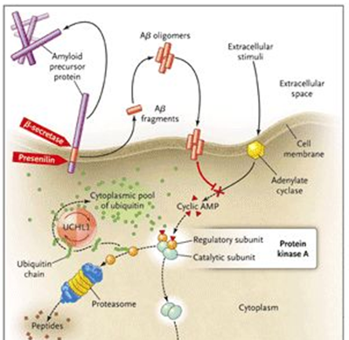
Molecules and Memory
Information unused
(no decision)
cAMP is recycled
PKA is inactivated
Phosphorylation stops
Memory gone
NEJM (2006) 355:25
Notes:
NEJM (2006) 355:25

Slide 35
Consolidation of Memory
New information → phosphorylation at neuron synapse (“illusion of memory”)
Two things can happen:
Use of the information for decision/action → sustained signal → gene activation → synthesis of new proteins → consolidation; neuron “remembers”
Rehearsal by hippocampus during sleep (5 REM cycles, 7.5 hrs, minimum)

Slide 36
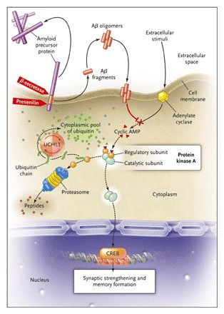
Gene Expression and Memory
e.g. glutamate receptors in the hippocampus (new memory)
NEJM (2006) 355:25
Notes:
NEJM (2006) 355:25

Slide 37
Experiential Learning Cycle Achieving Long Term Potentiation
Outside
Can it be used? [Act]
Experience new information [Sense]
What does it mean? [Integrate]
What is it? [Recognize]
Inside
Notes:
Our curriculum doesn’t ask for this cycle to be completed. Therefore, you have to decide to complete it for yourself.
Next week, Rob Carroll’s presentation will refer to this cycle with the admonition that medical education should offer opportunities to address all four steps.

Slide 38
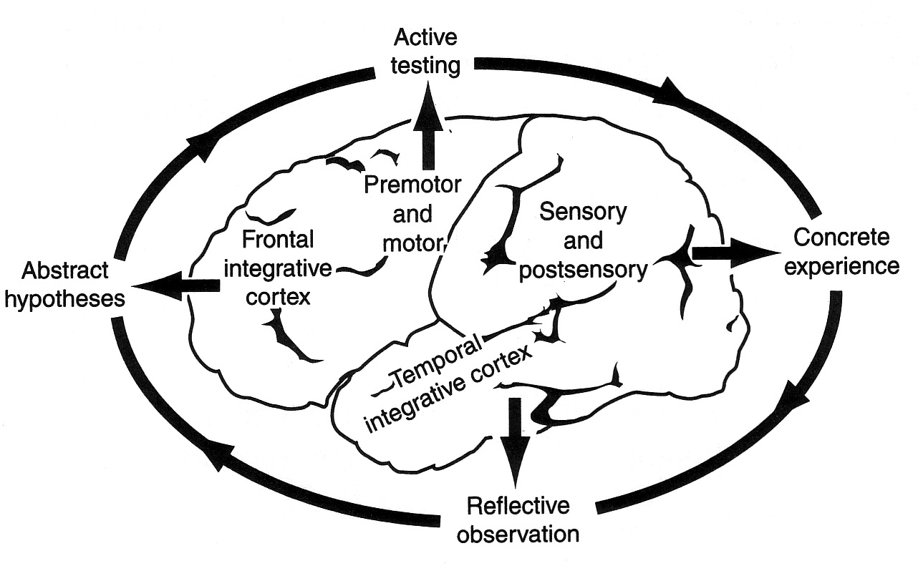
Experiential Learning By The Brain
Some Motor Skills
Sensory Skills
Thinking Skills
Memory Skills
Adapted from Zull, 2002, The Art of Changing the Brain
Notes:
Thinking and memory skills are what we evaluate on written tests.
We think that if students remember information that they can think with it.
Motor and sensory are also learned skills.

Slide 39
Receiving Information vs. Production Of Knowledge
Concrete experience; sensory cortex organizes information
Reflective observation; temporal cortex recognizes information
Abstract conceptualization; pre-frontal cortex evaluates and decides
Active testing; motor cortex acts on information – produces knowledge from the outcome.
Notes:
The general flow of information is “sense-integrate-act” (from Zull, see references)
Until a decision is made, new input from experience remains a simple experience.
When experience is integrated by the frontal cortex to produce a decision, an action results.
It is through the decision/action step that experience is transformed into knowledge.
The outcome of the action is the reinforcement, positive or negative, that serves as feedback.
Is there a correlation between the areas of the brain and HOTS?

Slide 40
Prefrontal Pause
How is recognition different from recall?
Related question: What area of the brain is responsible for each?
Notes:
Recognition is the ability to recognize, to process sensory input to match new input with remembered information. This is done by the temporal area.
Recall is the ability to reconstruct remembered information without the aid of sensory input usually to be used in making a decision. This is done by the frontal cortex.

Slide 41
Back To The Future
Temporal (back) processing
Facts, grouping, memorized patterns
From lectures, books, other resources
Information resource for prefrontal decision making
Pre-Frontal (future) processing
“Discovered” patterns, inferences, evaluation of options
Dialog requires a decision based on a rationale, Broca’s area is integrative
ALWAYS BE MAKING A DECISION!
Notes:
We engage the pre-frontal cortex as we progress into more complex learning. If you build the front the back will follow

Slide 42
What’s Your Favorite Lobe?
What information do you give the most attention to?
Sensing types; Temporal emphasized
Primarily sensory experience
Specifics, routine procedure
Intuitive types; Pre-frontal emphasized
Primarily predictive experience
The big picture, relationships, predictions

Slide 43
Neurobiological Effects of Concept Mapping
First, a look at concept mapping
Neurobiology of learning with concept maps
Deliberate Practice and concept maps

Slide 44
Anatomy Of A Concept Map
Key terms enclosed in “bubbles”
Fact = two connected bubbles
Connections can contain verbs
describes concept relationship
Branch points represent groupings and organization
Cross-links are comparisons and cause-and-effect; integrative thinking

Slide 45
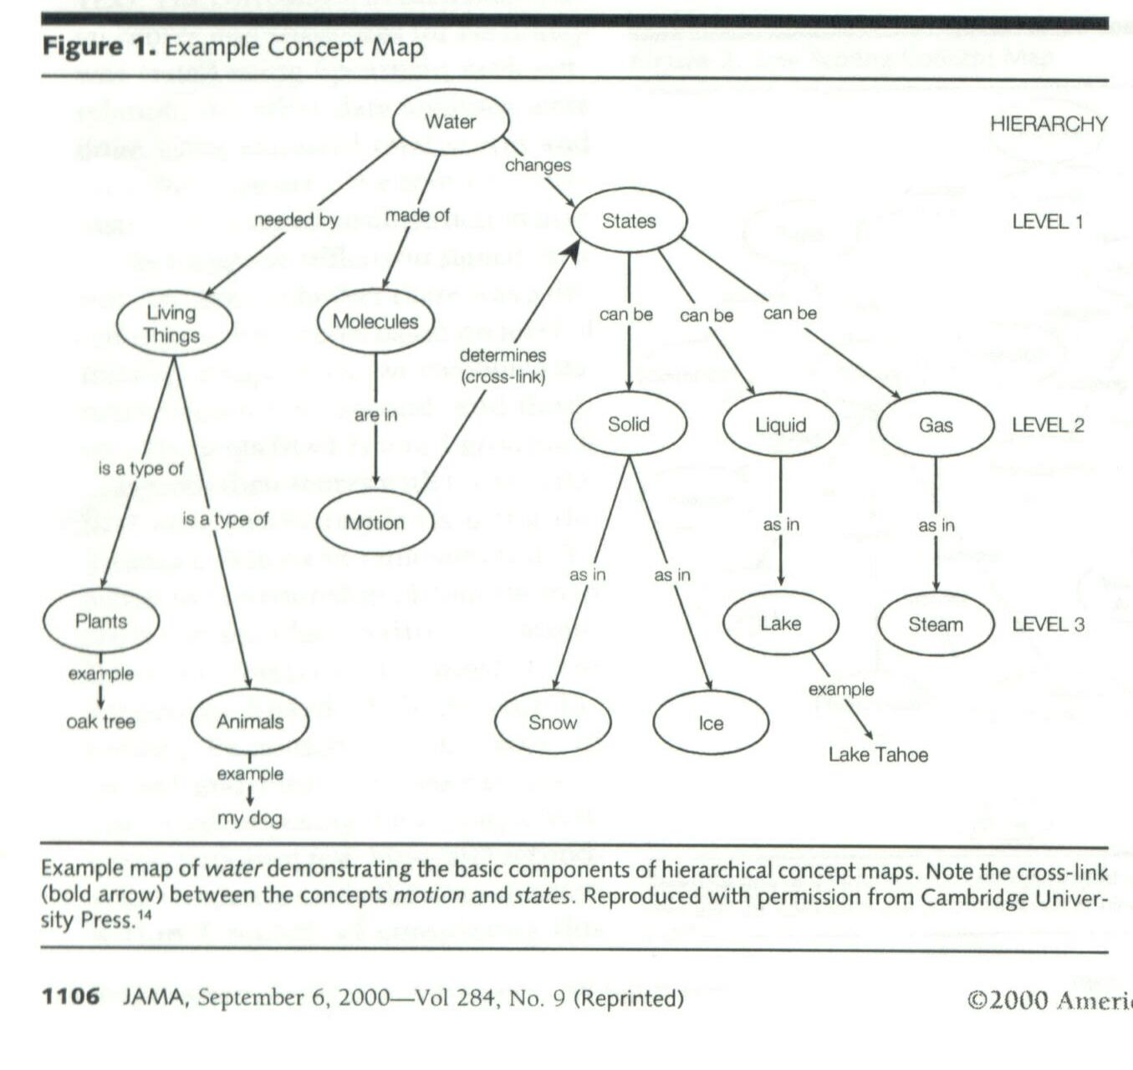
Notes:
Map of water

Slide 46
Overview of Mapping
List – Group – Compare
1. List important terms
2. Group by major topic
3. Compare by drawing cross-links
All three steps require use of Deliberate Practice in reading

Slide 47
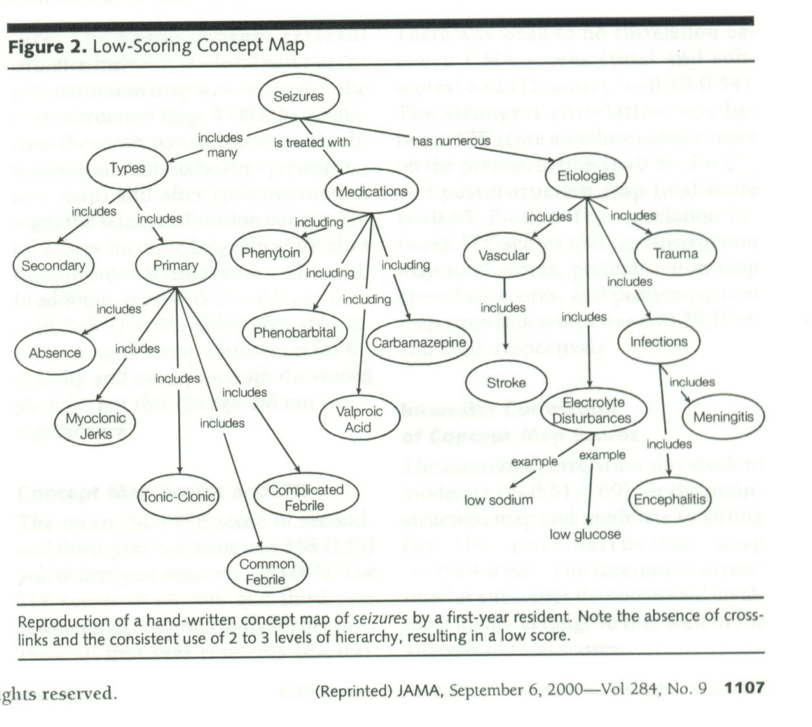

Slide 48
Concept Mapping and DP
One of the following will be harder to do than the others
Focus and attention (sensory/temporal/prefrontal)
Identifying the grouping terms (prefrontal/temporal)
Identifying subtopics (prefrontal/temporal)
Organizing relationships at each level of complexity (prefrontal/temporal)
Drawing the map (prefrontal/motor)

Slide 49
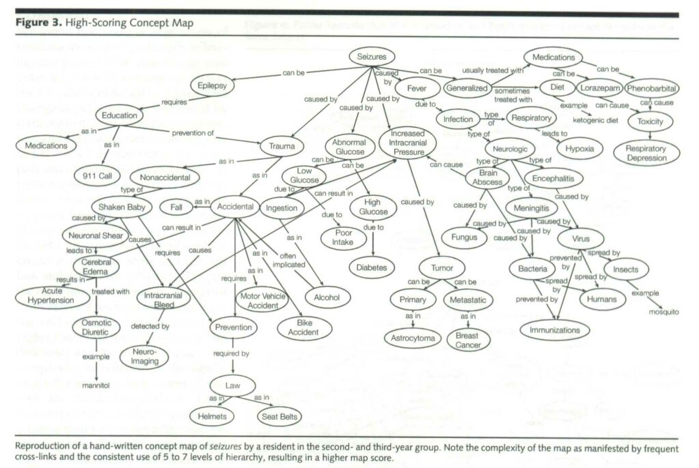

Slide 50
DP Outcomes From Concept Mapping
Slow at first as most-limiting brain function undergoes development
Limiting function is identified and practiced
Faster processing during consolidation of skill areas
Capacity to make decisions faster
Capacity to access long term memory faster
Capacity to retain fact (declarative) memory increased
Transfer of skill to other problem solving venues

Slide 51
More About Maps
Remember that maps are living documents; they grow as you learn
Maps don’t have to include everything
Maps are the best study notes
Maps allow you to compare your thinking
…and improve it!
Notes:
Students who refine their maps on weekends, never look at the book or their notes again – only their maps.

Slide 52
Question analysis
Each answer choice is studied in depth to establish conditions that rule out or accept
Understanding the correct answer.
Minimum knowledge to rule-in the correct answer
Understanding the wrong answers.
Minimum knowledge to rule-out the wrong answers
Rephrasing the question
Check SuccessTypes book at website
Notes:
Asking for minimum knowledge needed requires the student to make a decision

Slide 53
Question Analysis: “Ruling-Out” Thinking
Questions – ultimate learning objectives
Shows how are topics tested
Shows how you have to think
Understanding a question
Many do not test memorization, but organization and integration.
Teachers believe that they have addressed each “wrong” answer
Called rational alternatives
Each answer is correct for a different question.

Slide 54
Problem Solving Essentials – Summary Thoughts
Team contribution is critical
Learning “types” develop the non-preferred function faster when they hear it (experience!)
Develop “inter”-dependence
Mental functions are skills, not intelligence!
Mental functions are developed through Deliberate Practice.

Slide 55
Recap
Experiential learning “flows” through the cortex
Always completed through action
Personality type reflects time allocation.
Experiential learning develops both:
Cognitive memory
Critical thinking skills
Long-term memory is external evidence of dendritic tree growth (temporal cortex).
Critical thinking (analytic) skill is external evidence of dendritic tree growth (prefrontal cortex).

