Slide 1

FIU Benefits Overview
2026

Slide 2

Benefit Options
Medical
Dental
Vision
Life
Prescription Drug
Savings & Spending Accounts
Retirement
Supplemental & Vol Plans
Tuition Waiver
Holidays and Leave Time
Perks & Services

Slide 3
Benefit Premiums
Premiums are paid a month in advance
State Benefits
60 Calendar Days
FIU Benefits
90 Calendar Days
Biweekly payroll deductions (pre-tax)
Coverage start date depends on when you enroll
Medial Insurance effective the 1st day of the month following hire date (upon enrollment)
Example: Start date of June 16th, benefits effective July 1st
Supplemental plans (Dental, Vision, Life Insurance, etc.) effective 1st day of the 2nd month following hire date (upon enrollment)
Example: Start date of June 16th, benefits effective August 1st

Slide 4

Eligible Dependents
Legal Spouse
Child (up to age 26)
Legal Guardianship (up to age 26)
Over-age Dependent (up to age 30)
Disabled Child

Slide 5



Health Insurance Plan Options
Standard
HMO
High-Deductible HMO
High-Deductible PPO
In or Out of Network
% of Cost after Deductible
In or Out of Network
% of Cost after Deductible
Network only
Set Copayments
Low Deductible
Higher Deductible
No Deductible
Set Copayments
Standard
PPO
Network only
Higher Deductible
HMO carrier option based on contracted areas.
Verify provider network before electing a plan.
https://www.mybenefits.myflorida.com/myhealth/health_insurance_plans

Slide 6

Health Insurance Premiums
Standard Plan
Family – $64.30 /month
Individual – $15/month
High-Deductible Plan
Spouse Program Discount
If you and your spouse are both State employees, you can participate in the Spouse Program at a shared premium of $30.00 a month. Separate form required for enrollment.
Eligible for Health Savings Account (HSA) with State Contributions of:
Up to $500/year (Individual)
Up to $1000/year (Family)
Individual – $50/month
Family – $180/month
Rates based on 30 hours or more – PT employees verify with Benefits Department
Under High-Deductible plans, you are responsible for 100% of medical bills and prescription costs until annual deductible has been met.

Slide 7





Dental Plans
Prepaid/HMO
In-network care only
PPO
In/Out network care
Indemnity with PPO Network
Indemnity
In/Out network care
Deductible and Annual Max Apply
In/Out network care
Deductible
Deductible
No deductible
Copayments
No calendar year max
Annual Max Apply
Annual Max Apply
https://www.mybenefits.myflorida.com/content/download/404477/file/2026DentalPlanMonthlyPremiums.pdf

Slide 8

Vision Plans
Eye-exam once every 12 months
Frames once every 24 months
Lenses once every 12 months*
In and out network coverage
https://www.mybenefits.myflorida.com/myhealth/vision_insurance_plan

Slide 9

Life Insurance Plans
Basic Life Insurance
Automatically enrolled (FT Employees)
Paid by employer (FT Employees)
Coverage of $25,000
Optional Life Insurance
Paid by employee (Post Tax)
1 to 7 times annual salary, maximum benefit of $1,000,000
Rates based on age and salary
Medical Underwriting may be required
Dependent Life Insurance
Paid by employee (Post Tax)
Spouse Life
Child Life
https://www.mybenefits.myflorida.com/myhealth/life_insurance_plans

Slide 10

Prescription Drug Plan
 | Standard HMO and Standard PPO** (in network) |  | High-Deductible HMO and PPO ** (in network) | Standard & High-Deductible PPO (out of network)
Type of Medication | Retail | Mail Order Program | Retail and Mail Order* | Retail and Mail Order*
 | (up to a 30-day Supply) | (up to a 90-day Supply)
Generic | $7 | $14 | 30% | Pay in full and file a claim
Preferred Brand-Name | $30 | $60 | 30%
Non-preferred Brand-Name | $50 | $100 | 50%
**Member cost of prescription after satisfying the appropriate individual or family deductible.
**Mandatory Mail order required for maintenance drugs (Limited Pharmacy Pick-Ups Allowed).
Please note that certain drugs may be excluded and will require prior authorization to be covered.
https://www.mybenefits.myflorida.com/myhealth/prescription_drug_plan

Slide 11
Savings & Spending Accounts
 | Dependent Care FSA | Healthcare FSA | *Limited Purpose FSA | *Health Savings Account (HSA)
Employee Contributions | $60 Minimum/Year Review plan documents for applicable contributions limits Subject to change based on IRS Guidelines | $60 Min/Annual View | $60 Min/Annual $2,850 Max/Annual | $0 Minimum/Year Review plan documents for applicable contributions limits Subject to change based on IRS Guidelines
Deadline to Submit Claims | Funds must be used by March 15th of next plan year. Claims must be sent by April 15 of the next plan year | Funds must be used by December 31st of plan year. Claims must be submitted by April 15 of the next plan year |  | HSA works like a savings account Balance rolls over Take the money if or when you leave state employment
Remaining Balances | Any unused money will be lost to the State. | Unused funds may carry over to the next plan year. Carry over amount subject to change based on IRS Guidelines Funds in excess of the carry over maximum will be lost to the State.
Payments | Benny prepaid benefits card. Chard Snyder Plan Dashboard. Pre-Tax through Payroll Deductions – One “Benny” card for all plans
https://www.mybenefits.myflorida.com/myhealth/savings_and_spending_accounts

Slide 12


State Retirement Plans
FRS Pension
FRS Investment
State University System Optional Retirement Program (SUSORP)
As a new State employee:
Must choose one (1) retirement plan within specific enrollment deadlines.
Mandatory 3% contribution toward retirement plan from all eligible compensation.
SUSORP: FIU contributes, 5.14% vested immediately
Investment Plan: FIU contributes 8.3%, vested after 1 year
Pension Plan: vested after 8 years if initial enrollment is after 7/1/2011
https://www.myfrs.com/pdf/forms/SUSORP-Newsltr%206-22FP.pdf

Slide 13
Voluntary Retirement Plans
403(b) Plan
(Pre-tax & Roth)
457(b) Deferred Compensation
(Pre-tax & Roth)
Rollover other employer retirement accounts into 403(b) or 457 voluntary accounts.
Prior employee and/or employer plan contributions count towards the IRS limit for 403(b) and/or 457 voluntary accounts.
  Pre-tax contributions that lower taxable income
  Post-tax contributions that grow tax free
  Subject to IRS calendar year maximums
  Catch-up contribution for 50+
  Separate contribution limit from 457(b)
  Immediate vesting
  Multiple investment options
  Pre-tax contributions that lower taxable income
  Post-tax contributions that grow tax free
  Subject to IRS calendar year maximums
  Catch-up contribution for 50+
  Separate contribution limit from 403(b)
  Immediate vesting
  Multiple investment options
https://hr.fiu.edu/wp-content/uploads/2021/07/ORP-TDA-Providers-04.30.2021.pdf

Slide 14





Supplemental & Voluntary Plans
Accident
Cancer
Disability
Hospitalization
Hospital Intensive Care
Long Term Disability
Long Term Care
Life Insurance
https://www.mybenefits.myflorida.com/myhealth/other_supplemental_plans

Slide 15
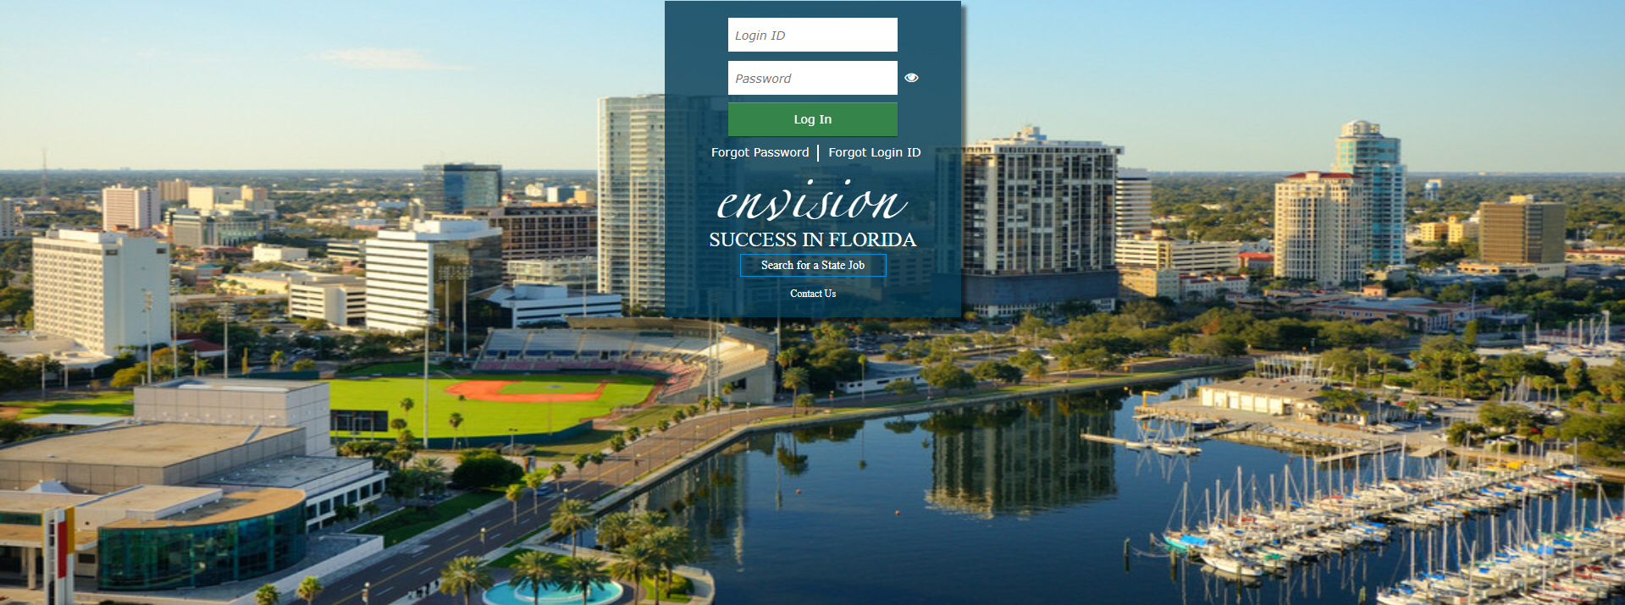
Enrollment Process
Health Benefits
Go to https://peoplefirst.myflorida.com
Select “Forgot Login ID” to retrieve your People First ID
You only need your Date of Birth and SSN
Select “Forgot Password” to establish password and security questions
Check video: How to Enroll in Insurance Benefits
Retirement Plan
FRS Plans – submit enrollment form online (ELE-1)
SUSORP – two-step process:
  Execute contract with SUSORP provider.
  Fill out ORP-Enroll form (forward to benefits@fiu.edu).
    Faculty employees of College of Medicine are mandatory members of the Optional Retirement Program and must use the ORP mandatory form.
Go to https://peoplefirst.myflorida.com

Slide 16

Tuition Waiver
Who’s eligible?
Full Time Employees
Per Semester
Employee: 6 credits
Dependent Child (up to age 24)
Spouse
Dependent: 4 credits
If employee does not use credits, dependent may use up to 10 credits
Online Enrollment
Further Information
305-348-4747
Tuition Waiver Program Overview
my.fiu.edu > self-service
Edward Leao, HR Service Center Manager

Slide 17

Holidays and Leave Accruals
Holidays
11 days
Vacation Time
Accrual: between 5-7 hours per pay period (varies based on years of service and/or employee classification)
Sick Time
Accrual: 4 hours per pay period
Leave Accruals — FIU Human Resources

Slide 18
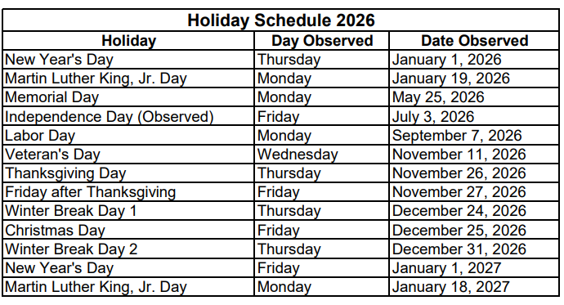
FIU Holidays

Slide 19
Leave of Absence
Family Medical Leave of Absence (FMLA)
Job-protected medical leave of absence:
Serious health condition of employee
Birth or adoption of a child
Care for a spouse, parent, or a child with a serious health condition
Leaves of Absence
Medical (Non-FMLA)
Military leave
Continuation of Salary Programs
Sick Leave Pool
Employee's own illness – up to 480 hours
Enrollment after 6 months of employment
Initial donation of 8 hours, annual donation of 4 hours
Part time employee would make contributions base Full Time Equivalency
Catastrophic Pool
Donations from Department – up to 480 hours
Professional Development
Personal Leave without Pay
https://hr.fiu.edu/employees-affiliates/life-events/leave-of-absence/

Slide 20
Worker’s Compensation
To Do:
In case of Medical Emergency:
Workers’ Compensation Assistant:
AmeriSys:
  Report to Supervisor
  Submit the FIU Injury Report online by clicking on Health & Safety Tile on the Panther Soft Home Page.
  For emergency transportation CALL Public Safety at (305) 348-5911
  Go to the nearest emergency room
  Mary Cruz
  305-348-2181
  workerscomp@fiu.edu
  Video Overview
  Emergency Contact:
  1-800-455-2079
On-the-job injuries MUST be reported IMMEDIATELY
Claims may be denied if not reported timely.
https://hr.fiu.edu/employees-affiliates/life-events/injuries-at-work/

Slide 21
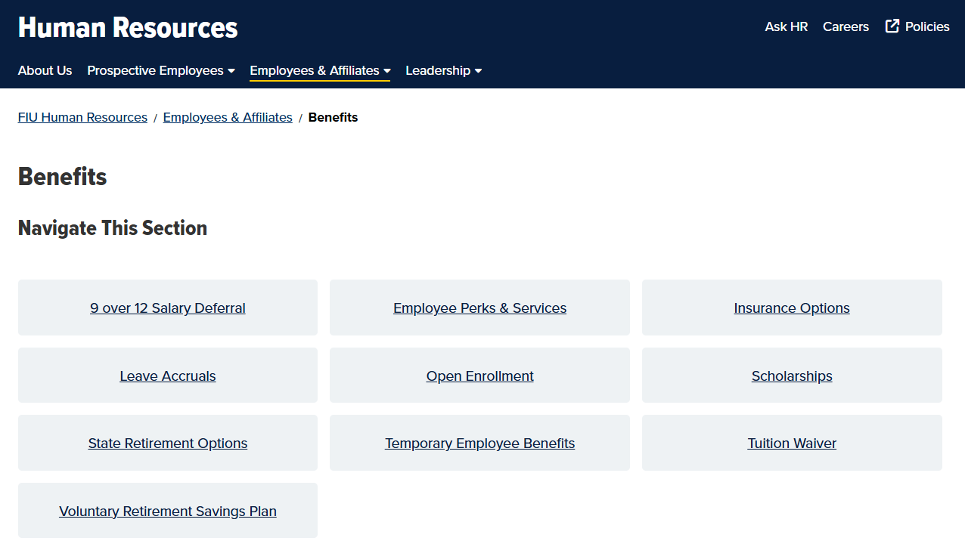
Employee Benefits
Visit the FIU Employee Benefits website for details of full benefits package!
https://hr.fiu.edu/employees-affiliates/benefits/
Questions?
Email Benefits@fiu.edu
https://hr.fiu.edu/employees-affiliates/benefits/perks-services/

Slide 22
Perks & Services
On Campus Services
Retail Discounts
Restaurants
Hotel & Travel
Entertainment Tickets
Financial Planning
Auto & Pet Insurance
Cellphone Plan Discount
Housing & Mortgage Services
https://hr.fiu.edu/employees-affiliates/benefits/perks-services/

Slide 23
Deadlines & Resources
Benefits Guide
State Benefits
60 Calendar Days
FIU Benefits
90 Calendar Days
FIU Insurance Options
Educational Benefit Videos
Contact Information

Slide 24

Natacha Alonso
Director of Human Resources
naalonso@fiu.edu /305.348.6315
Yasmira Lopez
Associate Director of Human Resources
lopezyas@fiu.edu /305.348.6025

Slide 25
THANK YOU!

