Slide 1
Poster Template Guidelines & Directions
Download the template and edit it to fit your content.
Do not alter or modify official logos.
Use a clear, legible font (preferred: Arial).
Follow branding standards: Use only template colors; avoid adding new colors.
The current poster size is 66 inches by 31.5 inches. To resize it, go to Design > Slide Size > Custom Slide Size, and then select the new dimensions.
If your poster requires additional logos, submit a marketing request to the COM Marketing Team. Please allow 3–4 weekdays to provide you with a modified temp.
QUESTIONS? Contact COM Marketing at medcomms@fiu.edu

Slide 2

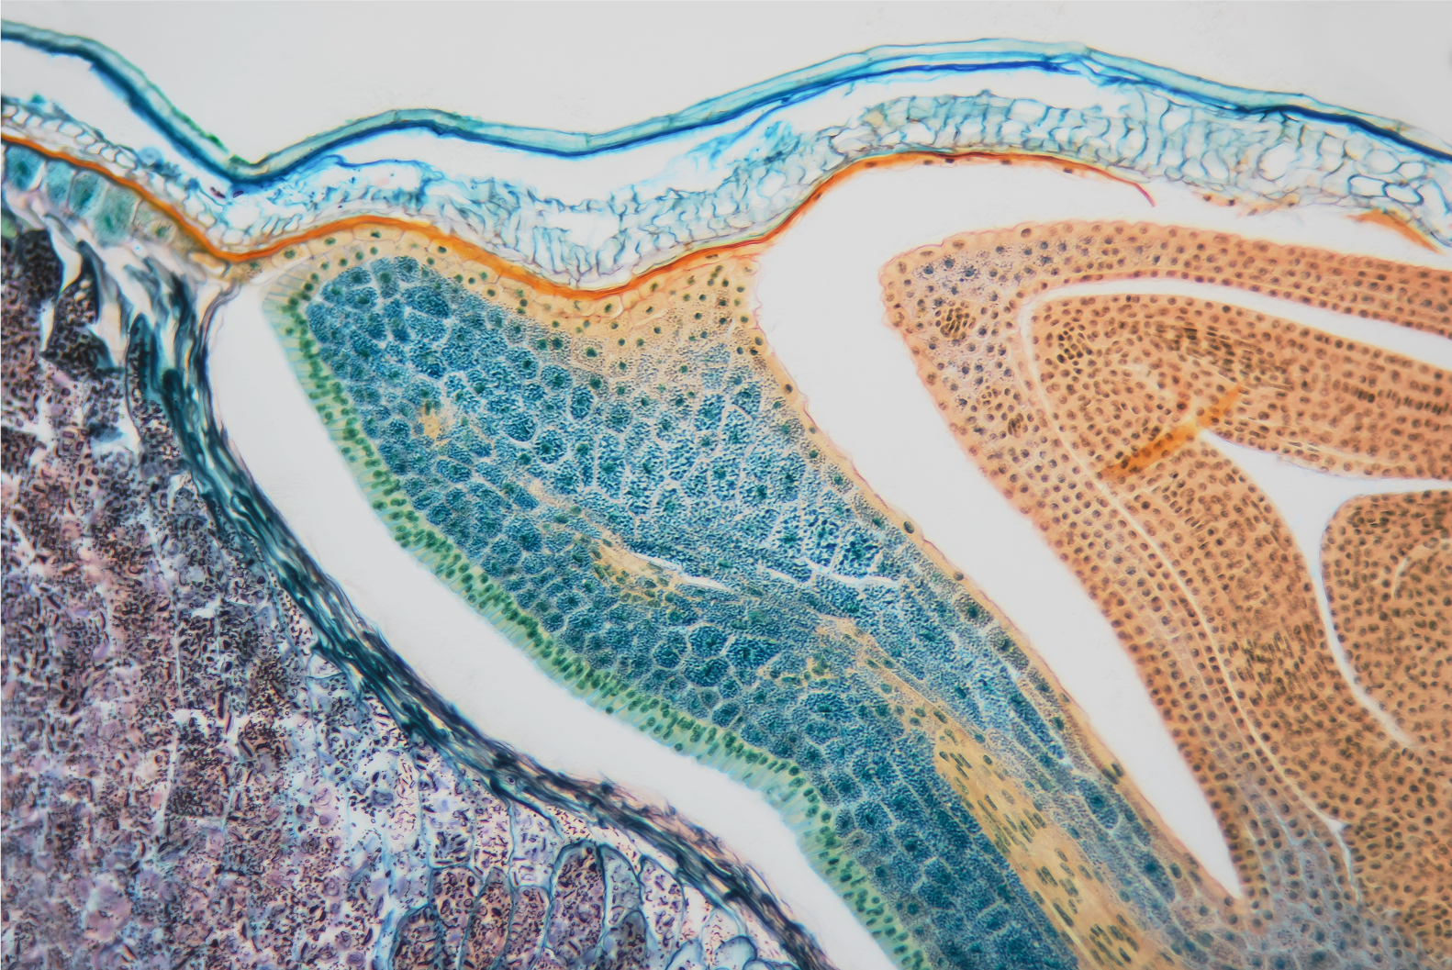
Enter the title of the study here
Name of the authors and institutional affiliations here
Background
Results
Conclusions
The main purpose of this section is to show that your study will provide new knowledge to those who see your poster.
Make sure the section is organized in a logical sequence; most times this section requires just three paragraphs.
Provide the basic background for the topic of the study.
Identify the gap in knowledge (nature / scope / magnitude of the gap).
This section describes the results of the study that are relevant for the study objective. Refer to what you found, not to what you did.
Present your results in a logical sequence: describe – bivariate – multivariate.
Most times this section contains up to three tables / figures and two / three paragraphs.
Start with tables and figures; use text later.
For tables and figures: check math, titles, headings and labels of columns, rows and axes, footnotes.
For text: highlight key relationships between independent and dependent variables; check that numbers in text are consistent with tables / figures.
The purpose of this section is to interpret your findings and justify such interpretation.
Most often this section requires four or five paragraphs.
Restate key results in connection with the objective(s) of the study.
Interpret your results in the context of previous studies.
State limitations / caveats of your study.
Make recommendations for: a) changes in practice / policy; and b) future studies.
Objective
Include here the objective(s) of the study.
Acknowledgements
Methods
Name here people or institutions that supported your study (logistically, financially, completing specific tasks). Do not include here the authors of the study mentioned in the title section..
The main purpose of this section is to describe how you collected, organized and analyzed data relevant for the study objective(s). Describe here what you did, not what you found. Organize the description in a logical sequence, respecting chronology. Most often this section requires the following paragraphs.
Study Design: Describe the study design and, in the case of secondary analysis, the original source of data..
Sample: Describe the selection (inclusion and exclusion) criteria and the selection process.
Variables:
Independent: Main exposure of interest.
Dependent: Primary and secondary outcomes.
Confounders: Potential confounders.
Data Analysis: Describe the methods used for analyzing the data.
References

