Slide 1
“The purpose of an educational institution is to lead the students, who initially believe the educational institution is there to educate them, to the realization that they must educate themselves.”
“They must …learn how to learn [integratively]…”
From Willis Hurst, MD, Medscape
[and Pelley]
Notes:
Need to teach real life, beyond the textbook. I planned a complete story, anything less would have lost the point. You all experience that all the time. What we have to decide is what part of this helps the student educate themselves. If you got the points I was able to make during the time allowed, you could get the rest from reading in my book.
How many followed up?

Slide 2
Writing Course and Clerkship Objectives
John W. Pelley, PhD
www.ttuhsc.edu/SOM/success
Notes:
Writing Course and Clerkship Objectives
The purpose of this session is to teach participants about the relationship between learning objectives and test questions. At the end of the session, the participants will be able to:
Compose objectives that address specific levels of complexity in learning.
Utilize available templates for easier objective writing
Use objectives to write test questions.
Note: This session will have a brief pre-class exerciseWriting objectives is difficult because we usually start with someone else’s organization of content and we focus on content and not what it is used for.

Slide 3
“Mind Bender”
Talk to a neighbor to answer,
“Is a test question an expectation or an outcome?”
And, “Are testing and evaluation the same thing?”

Slide 4
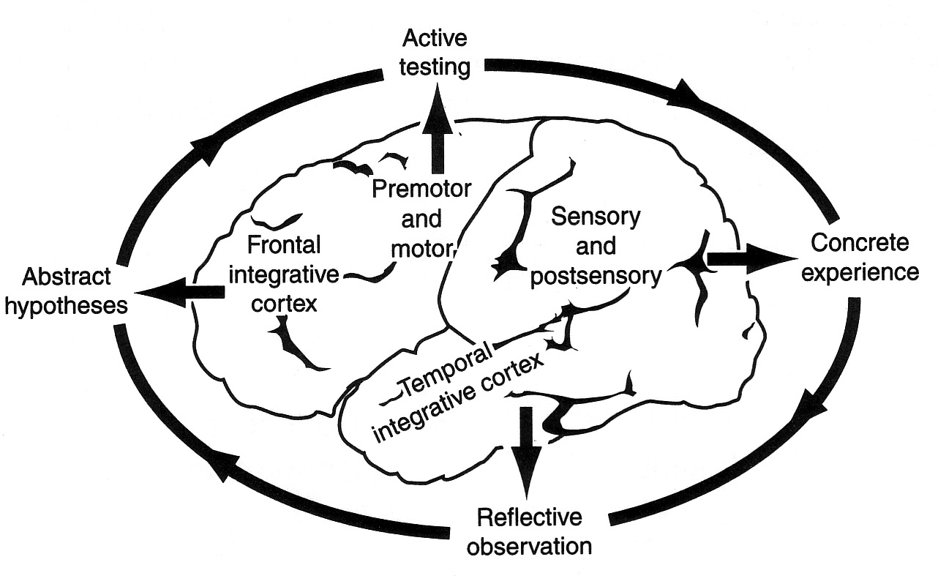
The Learning Cycle
Some Motor Skills
Sensory Skills
Thinking Skills
Memory Skills
Zull, 2002, The Art of Changing the Brain
Notes:
Thinking and memory skills are what we evaluate on written tests. We think that if students remember information that they can think with it.
Motor and sensory are also learned skills.
Active testing eventually becomes an exam, usually MCQ.
The results of the exam become concrete experience.

Slide 5
Expectations vs. Outcomes
Objectives state learning expectations
How well have the students used their brains?
Testing measures learning outcomes
Evaluation compares expectations vs. outcomes
Applies to teacher and students
Therefore,
Testing is what happened
Evaluation is what it means
Objectives help evaluation
Notes:
We expect 100 on every exam. How could they have not known that? I told them about it, they should have learned it the way I told them and they would have gotten it right. Experience shows that they didn’t make 100. what does it mean? Are they defective? Or, is my teaching defective? My teaching is clear to me, therefore, they must be defective.

Slide 6
Test Questions Are Outcomes – After The Test
Reliable and valid measure of:
teaching effectiveness
learning effectiveness
memory skills
thinking skills
Ambiguity in objectives affects reliability and validity.

Slide 7
Test Questions Are Expectations – Before The Test
Test questions are also learning objectives.
Learning objectives are most easily written as short essay test questions.
Long essay questions are too vague.
Effective objectives help in writing effective test questions!
Notes:
What does effective mean here? Reliability and validity

Slide 8
Objectives For Different Kinds Of Learning
State what you want the student to be able to do in an essay question format. Ask for
Written skills (e.g. typical study notes),
Oral skills (e.g. interviewing),
or Psychomotor skills (e.g. physical examination).

Slide 9
Example of Ambiguous Learning Objective
“Faculty will be able to modify course goals and objectives based on the principles taught at this session.”
But, why would I need to modify my objectives?
Also, what kind of objectives am I writing – teaching objectives or learning objectives?
And, will the modifications be an improvement? For who?
Conclusion: This objective doesn’t mean the same thing to everybody.
Notes:
You might think this objective is OK because it means something to you. But it is ambiguous.
It has to mean the same thing to everybody.

Slide 10
Better Learning Objective
For a given topic, participants will be able to…
determine the appropriate content to be learned.
determine the appropriate level of complexity to be learned.
compose a written objective that specifies a mental or physical behavior.
Notes:
These objectives allow you to be yourself; to exercise your own judgment.
These could still be made more specific but objectives can be stated at different levels of specificity depending on how you want to prepare the audience.

Slide 11
Restated As Essay Questions – “Learning Objectives”
For a given topic…
describe the appropriate content to be learned.
describe the appropriate level of complexity to be learned.
compose a written objective that specifies a mental or physical behavior.

Slide 12
GRIPE Objectives – Sample
Compare: coagulative necrosis; liquefactive necrosis; gangrenous necrosis; caseous necrosis; fat necrosis; fibrinoid necrosis; and apoptosis in terms of:
common sites or tissues involved and reasons for this
common causes or causative mechanisms
gross and microscopic appearance
types and extent of healing
(GRIPE = Group for Research in Pathology Education)

Slide 13
Learning Objectives Produce Teaching Objectives
If you think about the outcome (learning objectives), the teaching process will automatically follow.
Learning objectives help us
teach “thinking.”
write better test questions.

Slide 14
Levels Of Learning (Complexity)
Memorization skills
Recall (linear thinking) – “Just the facts ma’am”
HOTS (Higher Order Thinking Skills)
Analysis (grouping, indexing) – How are facts grouped into patterns?
Comparison (patterns) – How are patterns related?
Inference (concluding) – What is deduced? [diagnosis]
Evaluation (future vision) – What is predicted? [clinical treatment and management]
Notes:
Recall: Remembering or recognizing key facts, definitions, concepts, etc. Analysis: Understanding relationships between the whole and its component parts and between cause and effect. More than rote repetition; instead it involves reflectively structuring knowledge in new ways. E.g. granulomas in Chrons but not ulcerative colitis
Comparison: Explaining how relationships are similar and how they are different. Comparisons may be either simple or complex. Inference: Reasoning inductively or deductively. Asked to recognize or explain the evidence. Required to relate and integrate the information to come up with the generalization. Evaluation: Expressing and defending an opinion. Judges quality, credibility, worth, or practicality using established criteria and explain how the criteria area met or not met.

Slide 15
Learning Objective Examples
Recall – Define hyperglycemia, ketoacidosis, glycosylation
Analysis – Give the characteristics of type 1 diabetes.
Comparison – Explain how type 1 and type 2 diabetes are both similar and different.
Inference – Explain your diagnosis of type 2 diabetes.
Evaluation – Justify a treatment plan for a type 2 diabetic.

Slide 16
Pre-frontal Pause
Which level is most important?
Recall
Analysis
Comparison
Inference
Evaluation
Talk with a neighbor for 1 minute to decide.
Notes:
It depends on the situation.
Evaluation uses all the others, but it may be too advanced for the stage of the student.

Slide 17
Recall Level Objectives
List the ________ .
Describe ________.
Define the term ________.
Name ________.

Slide 18
HOTS Objectives
Explain how the conclusions are supported by the data/facts/evidence.
Compare (symptoms) before and after (procedure) .
Classify ________ according to ________ .
Distinguish ________ from ________.
Explain how ________ works.
Predict what will happen if (treatment).

Slide 19
Easier Objective Writing From NBME Question Templates
Use the NBME question templates in the handout materials “Creating Effective Learning Objectives and Test Questions .”
www.nbme.org
Item writers guide contains question templates

Slide 20
Sample NBME Question Template
Insert patient vignette describing a patient with a problem. Which of the following is the vessel into which contrast medium should be injected during fluoroscopy to visualize the site of the abnormality?
Question form:
“Which of the following is the vessel into which …”
Objective form:
“Explain where and why…”

Slide 21
A word of caution
If an objective requires a response that has been explicitly taught, it is actually testing only rote memory (recall).
A HOTS objective must require the student to generalize or apply what he or she knows to a new situation.

Slide 22
Recall Sample Questions
List the ________ .
Define the term ________.
What is a ________?
Who did ________?
Name ________.
Note: Any question becomes a recall question if the answer has already been explicitly provided to the student in class or in the text.

Slide 23
Recall Trigger Words
define
list
name
identify
who
what
when

Slide 24
Analysis Sample Questions
Classify ________ according to ________ .
Explain how ________ works.
What kind of a ________ is this?
What is the function of ________ ?
What is the relationship between ____ and ____ ? (classification/grouping relationships)

Slide 25
Analysis Trigger Words
break down
relationship
how it works
how it's used
give an example

Slide 26
Comparison Sample Questions
How is ________ like ________ ?
How are ________ and ________ different?
Compare the _____ before and after ______ .
Distinguish between _______ and ________ .
Compare ________ with ________ .
Which one is the best/worst?

Slide 27
Comparison Trigger Words
compare
contrast
distinguish
alike
different

Slide 28
Inference Sample Questions
Hypothesize what will happen if ________ .
Predict what will happen if ________ .
Solve the problem ________ .
What if ________ ?
What rule applies here?
What generalization can you make from this information?

Slide 29
Inference Trigger Words
hypothesize
synthesize
use (provide evidence found…)
apply (state a rule…)
generalize
what if
conclude
solve

Slide 30
Evaluation Sample Questions
Why was the argument convincing?
Did ________ behave/respond appropriately? Why?
What would you have done in this situation? Why?
Was this experiment well designed? Defend your answer.
Judge which is the best solution to the problem. Why do you think so?
How well are the conclusions supported by the data/ facts/evidence? Explain.
Which ________ is the best? Why do you think so?

Slide 31
Evaluation Trigger Words
judge
evaluate
best solution
justify
defend
critique
defend

