Slide 1
Examining Change & Emotional Agility
Isabel Alfonsin, M.S., LMHC, CEAP
December 7th 2018
Office of Employee Assistance

Slide 2
Agenda
Plaudits
Change
The Brain
Our Narratives
Our Choices
Agility & Attitude
Reflections

Slide 3
Thank you!
You rock!
Your contributions at the College of Medicine toward FIU’s over-arching goals are immense.
You touch lives, every day.
You matter.
Your commitment and collegiality is essential.
Your energy and engagement throughout this period of change is key!

Slide 4
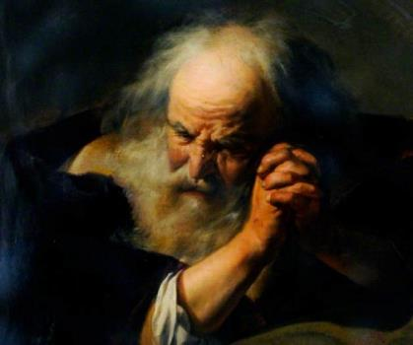
Heraclitus of Ephesus 500 BC
‘The Only Constant Is Change’

Slide 5
But first … a little Sheldon Cooper

Slide 6
It’s going to be fine.

Slide 7
The Brain – Part 1
The Growth Mindset
The Fixed Mindset
Dr. Carol Dweck

Slide 8
Two different sides of the coin.
Notes:
Depending on which way we see the challenge or opportunity.
Dweck’s work shows the power of our most basic beliefs. Whether conscious or subconscious, they strongly “affect what we want and whether we succeed in getting it.”
Much of what we think we understand of our personality comes from our “mindset.” This both propels us and prevents us from fulfilling our potential.
“Your view of yourself can determine everything”.
Therefore, if you can visualize yourself ABLE to undergo or be part of a change that involves you, YOU WILL, and to the extent that you can anticipate thriving beyond surviving it, your odds are better.

Slide 9
The Brain – Part 2

Slide 10
Which is it?

Slide 11
Perceptions

Slide 12
Correlation
Importance
Stress
Uncertainty
Notes:
So, obviously the proportion of our distress is directly related to the amount of importance something has for us and the degree to wish we know very little about what will happen.
These are important contributing factors. Don’t forget them. This will play a role on developing coping strategies later.

Slide 13
The Narratives
Just as important as what we think is what we say to ourselves (that little voice inside your head) when fear sets in.
“I am not equipped for this.” “ I am overwhelmed.” “I can’t do this.” “
THESE ARE JUST THOUGHTS, NOT FACTS.
Notes:
.

Slide 14
Self-transformation vs. Organizational Transformation

Slide 15
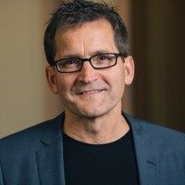
How can we make it better?
Find a way to make the organizational change feel more life self-transformational changes – empowering and energizing.
Jim Hemerling, Boston Consulting Group
The Era of Constant Change 2016 TedTalk in Paris, France

Slide 16
Why is it so exhausting?
Change is hard
People naturally resist change
Fear holds us back
Lack of perceived control is threatening
Sometimes change presents as a crisis (urgency leads to panic)
Sometimes change has been constant and cumulative

Slide 17
Why do we dread change?
The change management focus might be on short-term results – so what about the future?
What if in the pursuit of better & new we lost sight of the legacy and what was (if was pretty good, maybe even great)?
What if the change is not managed, reviewed or re-assessed once introduced?
What if the change(s) actually results in poor outcomes?

Slide 18
Achieving Successful Change – The 5 Forces of Change (2013)
Certainty
Purpose
Control
Connection
Success
Ambiguity
Lack of direction
Helplessness
Loss
Fear of Failure
Dr. Anthony Greenfield
Leeds University Business School, UK

Slide 19
Global Imperatives
Inspire Through Purpose – find the motivation linkage between yourself, your leadership and FIU.
Go All In – invest in the change & in one another because you are all in it working the change.
Enable – equip everyone with the capabilities that they need to succeed during & beyond the transformation.
Empowerment– beyond vision, a road map with milestones and holding each other accountable, be inclusive, compassionate and patient with self and others.

Slide 20
Dr. David Vago
Adaptive Mind-Body Interactions (2016) Tedx Talk in Nashville, TN.

Slide 21
Personal Imperatives
I am the
Creator
Of my
reality. Whatever
I focus ON
I create.
Jane Roberts, Seth, (1972)

Slide 22
Dr. Susan David
The Gift and the Power of Emotional Courage – TEDWomen 2017 – about 3.6M views.

Slide 23
Choices - Personal Agency
APPOINT YOURSELF THE AGENT OF YOUR OWN LIFE AND TAKE OWNERSHIP OF YOUR OWN DEVELOPMENT, CAREER, CREATIVE SPIRIT, WORK AND CONNECTIONS.

Slide 24
Choices - Personal Agility
MAKING HARD CHOICES CAN ACTUALLY BE LIBERATING BECAUSE IT HELPS YOU DEFINE WHO YOU TRULY ARE AND DEMONSTRATES THE POWER WE
ALL HAVE TO SHApE our lives.

Slide 25
Choices – Personal Attitude
CHOOSE COURAGE OVER COMFORT BY VITALLY ENGAGING WITH NEW OPPORTUNITIES TO LEARN AND GROW, RATHER THAN PASSIVELY RESIGNING YOURSELF TO YOUR CIRCUMSTANCES.

Slide 26
Practice the Three A’s
Agency
Attitude
Agility

Slide 27
Sir Winston Churchill (1874-1965)
“Fear is a reaction. Courage is a decision.”
AGENCY
“A pessimist sees the difficulty in every opportunity and the optimist sees the opportunity in every difficulty.
AGILITY
“Attitude is a little thing that makes a BIG difference.”
ATTITUDE

Slide 28
Change Coping Checklist
Breathe
Practice Mindfulness
Meditate/Pray
Welcome your experiences with openness
Be curious and non-judgmental
Embrace evolution (growth)
Let go of perfectionism and rigidity
Choose courage over comfort

Slide 29
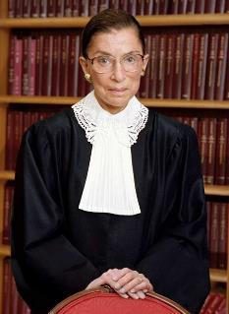
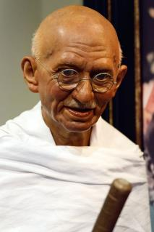
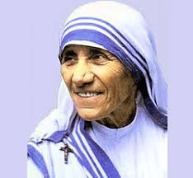
‘Courage is fear walking’ …
Notes:
Ruth Bader Ginsberg
Mother Theresa
Mahatma Gandhi

Slide 30
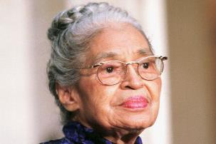
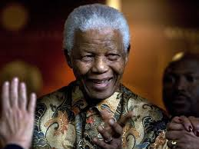
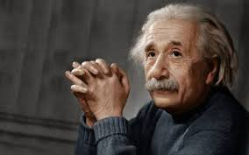
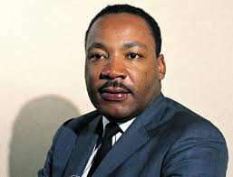
Notes:
Rose Parks
Nelson Mandela
Malala
Albert Einstein
Dr. Martin Luther King Jr.

Slide 31
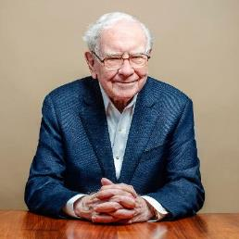
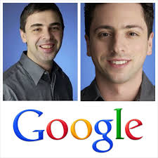
Notes:
Warren Buffett
Bill Gates
Steve Jobs
Larry Page and Sergey Brin

Slide 32
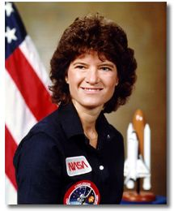
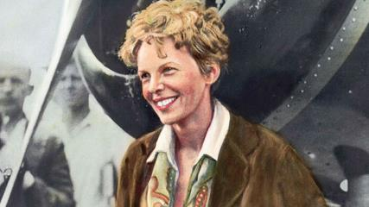
Notes:
Sally Ride
Michelle Obama
Amelia Earhart

Slide 33
We all get inspired, but…
What are you going to do with your inspiration?
THAT’s ALL UP to You.
PAWS UP!
Thank you!

